Slide 1
GROUP 1 | AI101 LAB 1
Saigon Route Lab
Tourist route planning across central Ho Chi Minh City
Notes:
Open with the tourist problem: the physically shortest route can be a poor choice when time, congestion, risk, and one-way streets matter.
[Sources]
C:/Users/Admin/Downloads/Lab 1 - Searching.pdf
C:/Users/Admin/Documents/AI01/lab-1/docs/TECHNICAL_REPORT.md

Slide 2
Five contributors, one integrated system
01 | Nguyễn Huy Hoàng | 24127378 | BFS, Vietnamese context, report introduction
02 | Nguyễn Đăng Hậu | 24127167 | DFS, graph model, dataset, cost function
03 | Nguyễn Thành Trung | 24127257 | UCS, route explanation, algorithm analysis
04 | Phùng Bảo Khang | 24127052 | A*, heuristic, GUI and visualization
05 | Thái Kiệt | 24127069 | Dijkstra, Greedy, multi-location optimization
2
Notes:
Introduce each member by ownership, then emphasize that every algorithm uses the same graph, request contract, and result schema.
[Sources]
C:/Users/Admin/Downloads/Tourist-route-planner-for-visiting-multiple-landmarks-in-Ho-Chi-Minh-City.pdf
C:/Users/Admin/Documents/AI01/lab-1/docs/TECHNICAL_REPORT.md

Slide 3
Every technical scoring requirement is implemented
01 | Real HCMC scenario | 24 landmarks on directed OpenStreetMap roads
02 | Six algorithms | BFS, DFS, UCS, A*, Dijkstra, and Greedy
03 | Traffic-aware cost | distance, time, congestion, and risk
04 | Multi-location | Nearest Neighbor and Exact Brute Force
05 | Explainable GUI | live trace, metrics, alternatives, and verification
3
Notes:
Connect these five project capabilities to the official rubric before moving into implementation evidence.
[Sources]
C:/Users/Admin/Downloads/Lab 1 - Searching.pdf
C:/Users/Admin/Documents/AI01/lab-1/docs/TECHNICAL_REPORT.md

Slide 4
A real HCMC road graph makes search measurable
HYBRID DATASET
OpenStreetMap supplies road geometry, classes, and directionality; deterministic profiles add traffic and risk. The graph includes 403 one-way edges and 24 unique landmark nodes.
24
481
995
landmarks
routable nodes
directed edges
4
Notes:
Explain the hybrid-data choice: real map structure plus controlled traffic scenarios makes every algorithm comparison reproducible.
[Sources]
C:/Users/Admin/Documents/AI01/lab-1/docs/DATA_DESCRIPTION.md
C:/Users/Admin/Documents/AI01/lab-1/lab-1-backend/docs/benchmark_results.json
https://www.openstreetmap.org/copyright

Slide 5
One weighted model keeps every algorithm comparable
Directed state space
State = road node. Action = follow an outgoing directed edge. Goal = the selected landmark node.
Edge evidence
Distance, time, congestion, risk, road type, one-way metadata, and route geometry.
Weighted cost
C(e) = alpha*distance + beta*time + gamma*congestion + delta*risk. Every term is non-negative.
Admissible heuristic
h(n) = alpha*Haversine(n, goal). The complete audit found zero consistency violations.
5
Notes:
Stress that comparisons are controlled: only the frontier policy changes; graph, endpoints, cost weights, and traffic profile remain fixed.
[Sources]
C:/Users/Admin/Documents/AI01/lab-1/docs/TECHNICAL_REPORT.md
C:/Users/Admin/Documents/AI01/lab-1/lab-1-backend/docs/full_audit_results.json

Slide 6
Profiles and objectives change costs, not topology
Normal
Base road-class travel time
Base congestion and risk
Deterministic baseline
Rush hour
Raises time and congestion
Larger multiplier on major roads
May keep or change the route
Rainy
Raises time, congestion, and risk
Can alter edge priorities
Produces a reproducible scenario
Five objectives
Balanced | Fastest | Shortest
Low congestion | Low risk
348/552 pairs change by criterion
6
Notes:
Make clear that profiles do not invent new roads. They change edge attributes and therefore the weighted cost evaluated by every algorithm.
[Sources]
C:/Users/Admin/Documents/AI01/lab-1/docs/TECHNICAL_REPORT.md
C:/Users/Admin/Documents/AI01/lab-1/lab-1-backend/docs/full_audit_results.json

Slide 7
One example graph exposes every guarantee
B
cost 1
Two competing routes
A -> B -> G: 2 edges, weighted cost 9
A -> C -> D -> G: 3 edges, weighted cost 3
Adjacency at A lists B before C
h(A,B,C,D,G) = 2,0,2,1,0
cost 8
A
G
cost 1
cost 1
C
D
cost 1
7
Notes:
This example was designed by the group. Use it for all six algorithms so expansion order, frontier state, parent updates, and guarantees remain directly comparable.
[Sources]
C:/Users/Admin/Documents/AI01/lab-1/docs/ALGORITHM_WALKTHROUGH.md
C:/Users/Admin/Downloads/Lab 1 - Searching.pdf

Slide 8
BFS and DFS follow structure; UCS follows cost
BFS | FIFO
Expand: A, B, C, G
Frontier: [B,C] -> [C,G] -> [G,D]
Path: A -> B -> G | cost 9
Guarantee: minimum edge count
DFS | LIFO
Expand: A, B, G
Stack: [C,B] -> [C,G]
Path: A -> B -> G | cost 9
Guarantee: none for route quality
UCS | min g
Pop: A(0), C(1), D(2), G(3)
Frontier: C:1/B:8 -> D:2/B:8
Path: A -> C -> D -> G | cost 3
Optimal for non-negative costs
8
Notes:
Read the frontier after each expansion. The contrast is the point: BFS minimizes depth, DFS commits to one branch, and UCS accepts the goal only when it is popped at minimum g.
[Sources]
C:/Users/Admin/Documents/AI01/lab-1/docs/ALGORITHM_WALKTHROUGH.md
C:/Users/Admin/Documents/AI01/lab-1/docs/TECHNICAL_REPORT.md

Slide 9
A-star balances g+h; Greedy ignores accumulated cost
A* | g+h
Pop f: A(2), C(3), D(3), G(3)
g/h/f: A 0/2/2; C 1/2/3
D 2/1/3; G 3/0/3 | cost 3
Optimal with admissible, consistent h
Dijkstra | g
Pop: A(0), C(1), D(2), G(3)
Same one-goal order as UCS here
Path: A -> C -> D -> G | cost 3
Also provides single-source caching
Greedy | h
Pop h: A(2), B(0), G(0)
Frontier: B:0/C:2 -> G:0/C:2
Path: A -> B -> G | cost 9
Fast here, but not cost-optimal
9
Notes:
Show g, h, and f explicitly for A*. For Greedy, point out the missing accumulated g term; that omission explains the cost-9 result.
[Sources]
C:/Users/Admin/Documents/AI01/lab-1/docs/ALGORITHM_WALKTHROUGH.md
C:/Users/Admin/Documents/AI01/lab-1/docs/TECHNICAL_REPORT.md

Slide 10
Frontier priority determines the guarantee
THEORY
Finite graph, deterministic tie-breaking, non-negative edge costs; A* uses an admissible Haversine lower bound.
Algorithm | Frontier key | Complete here | Optimality | Worst-case time
BFS | FIFO depth | Yes | Edge count only | O(V + E)
DFS | LIFO depth | Yes, finite | No | O(V + E)
UCS | min g | Yes | Weighted cost | O((V+E) log V)
A* | min g+h | Yes | With admissible h | O((V+E) log V)
Dijkstra | min g | Yes | Weighted cost | O((V+E) log V)
Greedy | min h | Yes, finite | No | O((V+E) log V)
10
Notes:
Use this as the bridge from the group-designed graph to the full HCMC dataset. The guarantees depend on the assumptions stated in the subtitle.
[Sources]
C:/Users/Admin/Documents/AI01/lab-1/docs/TECHNICAL_REPORT.md
C:/Users/Admin/Documents/AI01/lab-1/docs/ALGORITHM_WALKTHROUGH.md

Slide 11
One API contract connects interface and search
1 | React + Leaflet
Select inputs, render the map, display route metrics, and replay the live search trace.
2 | FastAPI contract
REST serves bootstrap, compare, and multi results; WebSocket streams search steps.
3 | Shared search core
One graph, cost function, and result contract drive all six independent algorithm entry points.
4 | Explanation + multi
Alternative-route facts and cached pairwise Dijkstra support explainable visiting-order optimization.
11
Notes:
Walk left-to-right through the request. The GUI never reimplements search logic; it consumes one shared backend contract.
[Sources]
C:/Users/Admin/Documents/AI01/lab-1/docs/TECHNICAL_REPORT.md
C:/Users/Admin/Documents/AI01/lab-1/docs/DEMO_SCRIPT.md

Slide 12
A* saves 46 expansions; Greedy trades cost for speed
NOTRE DAME -> SAIGON ZOO
Balanced criterion, normal traffic; median of 10 in-process runs on one development machine.
Algorithm | Cost | km | min | Expanded | Generated | Median ms
BFS | 7.661 | 2.046 | 2.977 | 206 | 226 | 0.890
DFS | 35.768 | 7.598 | 9.733 | 150 | 183 | 0.982
UCS | 7.661 | 2.046 | 2.977 | 218 | 244 | 0.294
A* | 7.661 | 2.046 | 2.977 | 172 | 192 | 0.570
Dijkstra | 7.661 | 2.046 | 2.977 | 218 | 244 | 0.292
Greedy | 7.738 | 1.422 | 1.942 | 19 | 37 | 0.135
12
Notes:
UCS, A*, and Dijkstra agree on the minimum weighted cost. A* expands 46 fewer nodes than UCS/Dijkstra. Greedy expands only 19 nodes but returns a slightly higher weighted cost; do not generalize runtime from one machine.
[Sources]
C:/Users/Admin/Documents/AI01/lab-1/lab-1-backend/docs/benchmark_results.json
C:/Users/Admin/Documents/AI01/lab-1/docs/TECHNICAL_REPORT.md

Slide 13
Rain changes the route; rush hour raises its cost
Normal
Cost 9.365
2.140 km | 3.223 min
Baseline road sequence
Rush hour
Cost 11.834
2.140 km | 5.394 min
Same roads; about 67% more time
Rainy
Cost 13.184
2.145 km | 4.409 min
Changes via Ly Tu Trong / Hai Ba Trung
Across the graph
177 of 552 ordered pairs
change path in at least one profile
Scenario: Ben Thanh -> Independence Palace
13
Notes:
Use Ben Thanh Market to Independence Palace in the demo. Rush hour keeps the selected roads in this case, while rain changes the road sequence because time and risk penalties alter priorities.
[Sources]
C:/Users/Admin/Documents/AI01/lab-1/lab-1-backend/docs/benchmark_results.json
C:/Users/Admin/Documents/AI01/lab-1/docs/TECHNICAL_REPORT.md

Slide 14
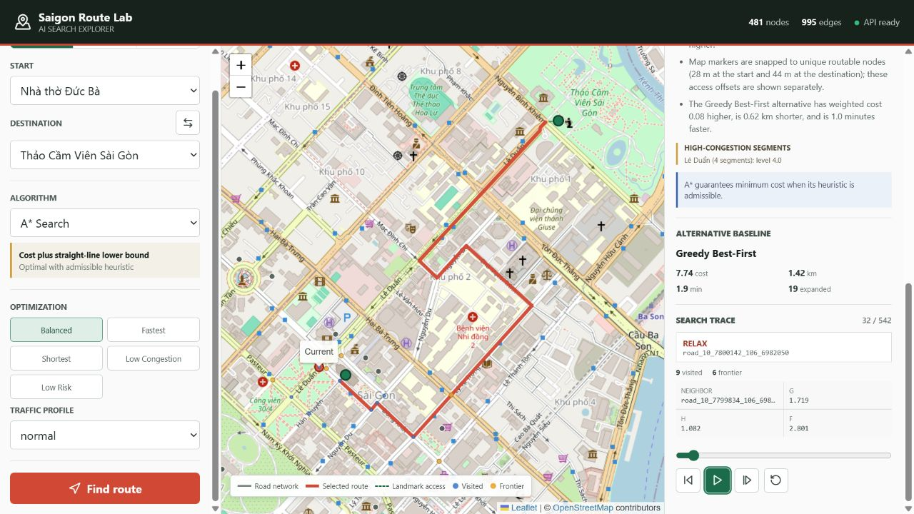
Single mode explains route, alternative, and live trace
14
Notes:
Point out the selected route, access offsets, visited/frontier/current nodes, g-h-f trace values, named congestion segment, optimality statement, and distinct alternative route.
[Sources]
C:/Users/Admin/Documents/AI01/lab-1/docs/images/single-search.jpg
C:/Users/Admin/Documents/AI01/lab-1/docs/TECHNICAL_REPORT.md
https://www.openstreetmap.org/copyright

Slide 15
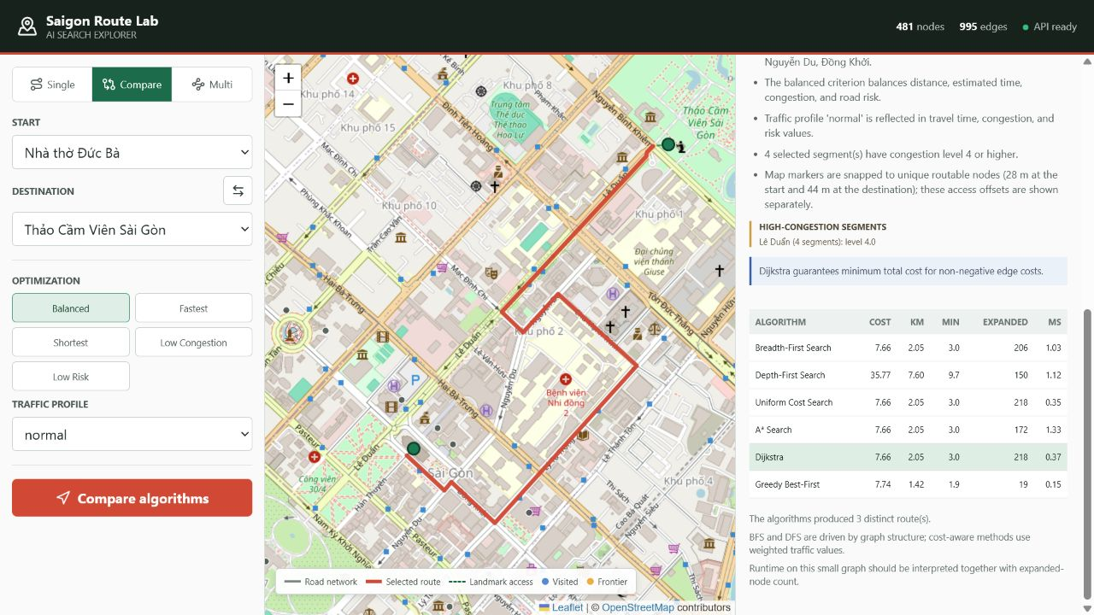
Compare mode holds every control constant
15
Notes:
Select several rows during the demo so the mapped route updates. Compare cost, distance, time, expanded nodes, and runtime under identical endpoints, criterion, and traffic profile.
[Sources]
C:/Users/Admin/Documents/AI01/lab-1/docs/images/algorithm-comparison.jpg
C:/Users/Admin/Documents/AI01/lab-1/docs/TECHNICAL_REPORT.md
https://www.openstreetmap.org/copyright

Slide 16
Multi-routing compares speed with exact proof
Nearest Neighbor
Visit the cheapest unvisited waypoint at each step. O(k^2) route-choice work; fast but approximate.
Exact Brute Force
Evaluate every waypoint permutation. O(k!) ordering work; exact for the reduced pairwise problem.
Shared preprocessing
Cached single-source Dijkstra runs build the important-node pairwise path and cost matrix.
Route constraints
Fixed end, return to start, duplicate removal, and explicit failure for unreachable mandatory segments.
16
Notes:
State the optimality boundary precisely: Exact is optimal for the reduced pairwise shortest-path problem, not an unrestricted physical traveling-salesperson model.
[Sources]
C:/Users/Admin/Documents/AI01/lab-1/docs/TECHNICAL_REPORT.md
C:/Users/Admin/Documents/AI01/lab-1/lab-1-backend/docs/benchmark_results.json

Slide 17
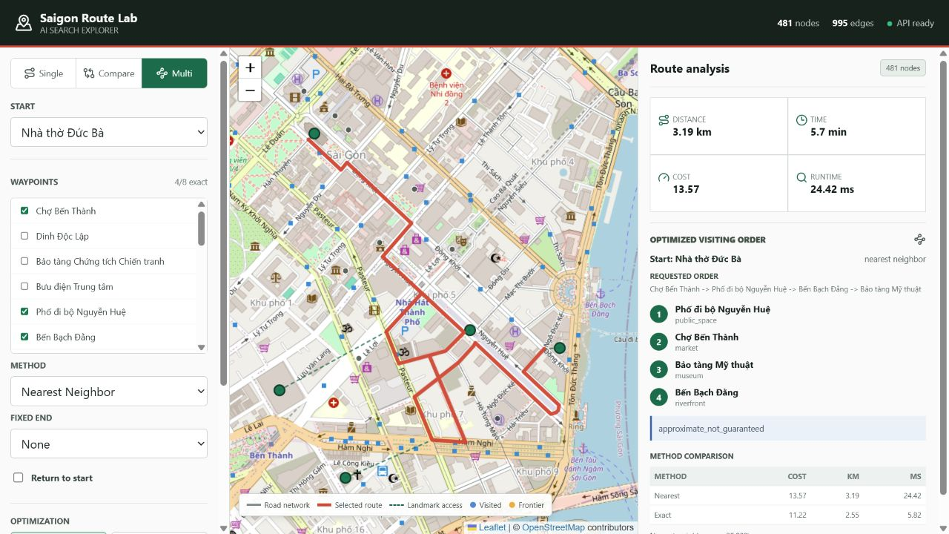
Exact beats nearest neighbor by 20.88%
17
Notes:
Use the four-stop case shown. Nearest costs 13.57; Exact costs 11.22. The 20.88% gap demonstrates that a locally cheapest next stop can produce a worse full tour.
[Sources]
C:/Users/Admin/Documents/AI01/lab-1/docs/images/multi-route.jpg
C:/Users/Admin/Documents/AI01/lab-1/lab-1-backend/docs/benchmark_results.json
https://www.openstreetmap.org/copyright

Slide 18
Verification covers algorithms, APIs, UI, and all pairs
83 automated tests
70 backend and 13 frontend tests cover algorithms, contracts, validation, WebSocket, and UI lifecycle.
552 / 552 pairs
Every ordered landmark pair is reachable; UCS, A*, and Dijkstra match optimal cost on all pairs.
A* audit
Zero consistency violations across 995 directed edges, 24 goals, and five weight presets.
Release checks
TypeScript build, desktop/mobile workflows, clean console, stale-request control, and fault handling all pass.
18
Notes:
Separate reproducible correctness claims from benchmark observations. Mention the exhaustive audit command and the production frontend build.
[Sources]
C:/Users/Admin/Documents/AI01/lab-1/lab-1-backend/docs/full_audit_results.json
C:/Users/Admin/Documents/AI01/lab-1/docs/TECHNICAL_REPORT.md
C:/Users/Admin/Documents/AI01/lab-1/lab-1-frontend/src/App.test.tsx
C:/Users/Admin/Documents/AI01/lab-1/lab-1-frontend/src/api.test.ts

Slide 19
Known limits define the next engineering steps
Traffic realism
Current profiles are derived, not live. Next: integrate congestion, incident, and flooding feeds.
Landmark access
Six offsets exceed 100 m; maximum is 383.5 m. Next: project landmarks to real road edges.
Network scope
One transparent boundary connector joins two extracts. Next: use one continuous OSM study area.
Multi-stop scaling
Exact search is capped at eight waypoints. Next: dynamic programming, metaheuristics, and multiple vehicles.
19
Notes:
State these limits before the conclusion. They keep the realism and optimality claims honest while showing a concrete path forward.
[Sources]
C:/Users/Admin/Documents/AI01/lab-1/docs/TECHNICAL_REPORT.md
C:/Users/Admin/Documents/AI01/lab-1/lab-1-backend/docs/full_audit_results.json
C:/Users/Admin/Documents/AI01/lab-1/docs/DATA_DESCRIPTION.md

Slide 20
CONCLUSION
Search strategy changes
route quality
Six algorithms under one model
Real HCMC traffic context
Explained, benchmarked, verified
Notes:
Close by linking the opening problem to the evidence: route quality depends on the objective, frontier policy, and traffic scenario; the system makes those trade-offs visible and reproducible.
[Sources]
C:/Users/Admin/Documents/AI01/lab-1/docs/TECHNICAL_REPORT.md
C:/Users/Admin/Documents/AI01/lab-1/lab-1-backend/docs/benchmark_results.json
C:/Users/Admin/Documents/AI01/lab-1/lab-1-backend/docs/full_audit_results.json

